Slide 1

Multi-layer Security Integration Based On SIEM Solution
Presented by :
Sujal Lamichhane
Nirmal Adhikari
Ujjwal Kandel

Slide 2
Table of Contents
Multi-Layer Security Overview
Problem Statement
Project Objectives
System Architecture
Technologies Used
Agent Installation on pfSense
Suricata Integration
Wazuh SIEM with Virus Total & Postfix
Vulnerable System
Demonstration Screenshots
Conclusion

Slide 3
Multi-layer Security Overview
Defense-in-depth: Network, Host, Application layers
Early detection, efficient response
Reduces risk of single point failure
Enhances visibility and threat hunting capabilities

Slide 4
Problem Statement
Lack of Real-Time Monitoring: Many organizations — especially small businesses and schools — lack the capability to monitor and respond to threats in real-time.
Missed Attacks: Simple brute-force logins, port scans, and reverse shells often go unnoticed due to poor or absent IDS/IPS setups.
High Cost of Security Solutions: Commercial SIEM and intrusion detection tools are very expensive and out of reach for many.
Poor Integration Between Systems: Security systems are often fragmented, causing delayed response, poor visibility, and operational inefficiency.
Lack of Hands-On Learning Labs: For students and researchers, the absence of practical, interactive labs limits the learning of cybersecurity operations.

Slide 5
Objectives
Build a secure lab with pfSense + Suricata + Wazuh to mimic an enterprise SOC
Deploy Suricata IDS/IPS to spot scans, brute-force attempts, and known exploits
Centralize logs in Wazuh SIEM for correlation, analysis, and alerting
Stream real-time alerts for full visibility into network and host events
Showcase layered defenses (network + endpoint) working together.

Slide 6





Technologies USED
pfSense Firewall
Suricata – IDS/IPS
Wazuh – SIEM Platform
Virus Total
Vulnerable System

Slide 7
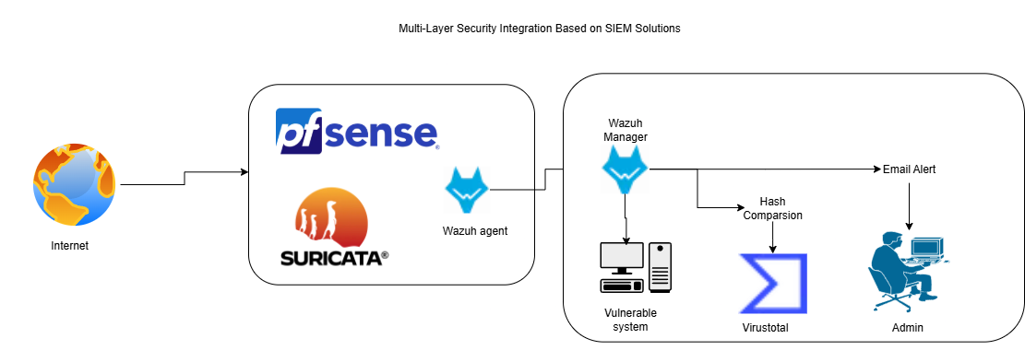
System Architecture

Slide 8
Agent Installation on pfSense
Install Wazuh agent via pkg
Configure ossec.conf to match Wazuh manager IP
Enable necessary ports and secure transmission
Verify connectivity with Wazuh dashboard

Slide 9
Suricata with pf-Sense
Suricata package via pfSense repository
Rulesets (ET open, Emerging Threats, Snort rulesets & others)
Logs forwarded to Wazuh for correlation
Real-time traffic inspection

Slide 10
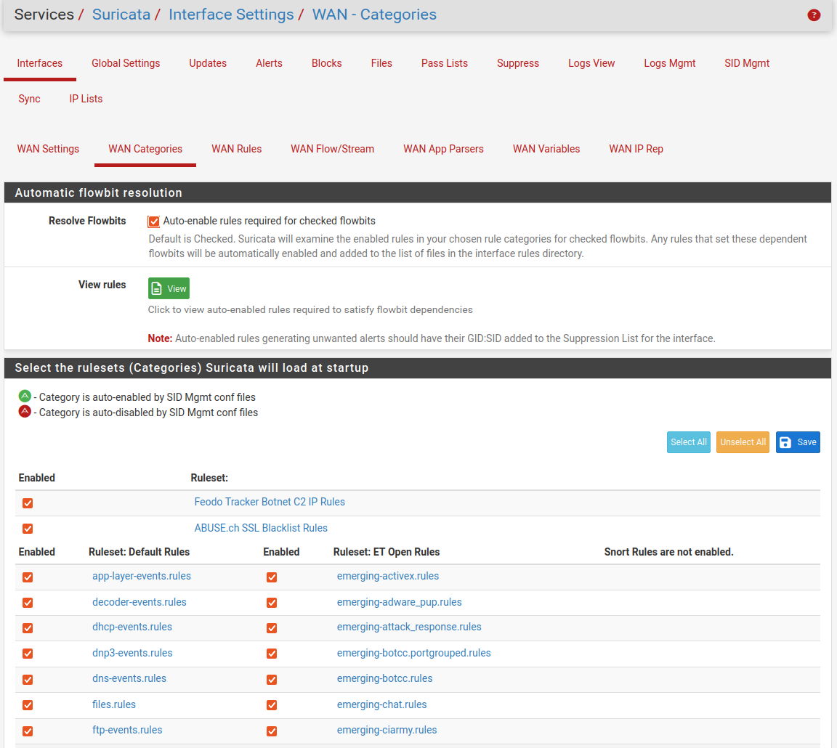
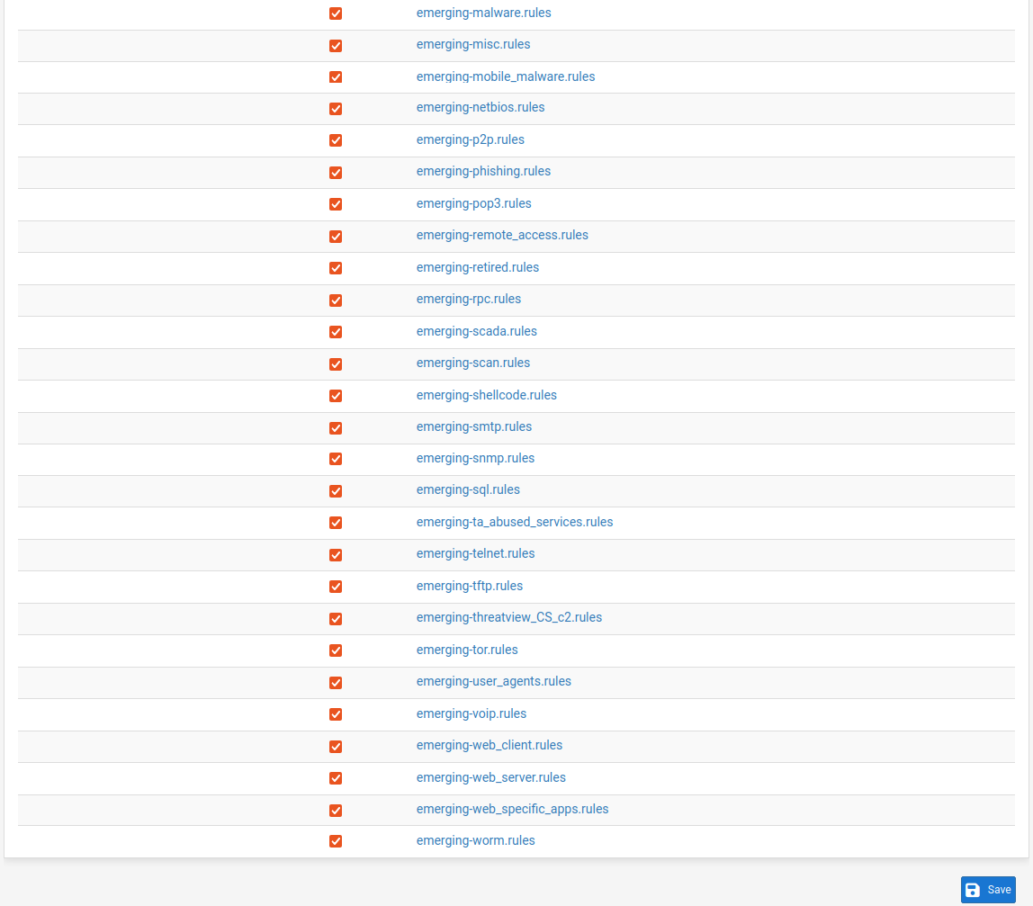
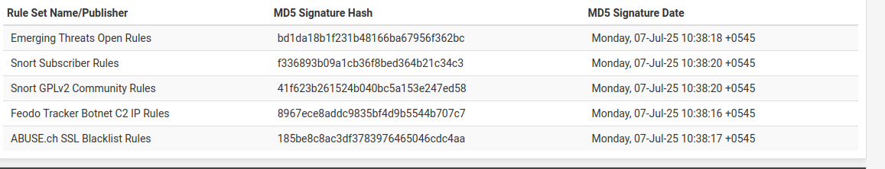
Rule set

Slide 11
Wazuh SIEM Platform
Centralized log collection & analysis
Integration with pfSense, Virus Total, Postfix Server, Window 10 pro
Rules engine for suspicious activity detection
Real-time alert generation

Slide 12
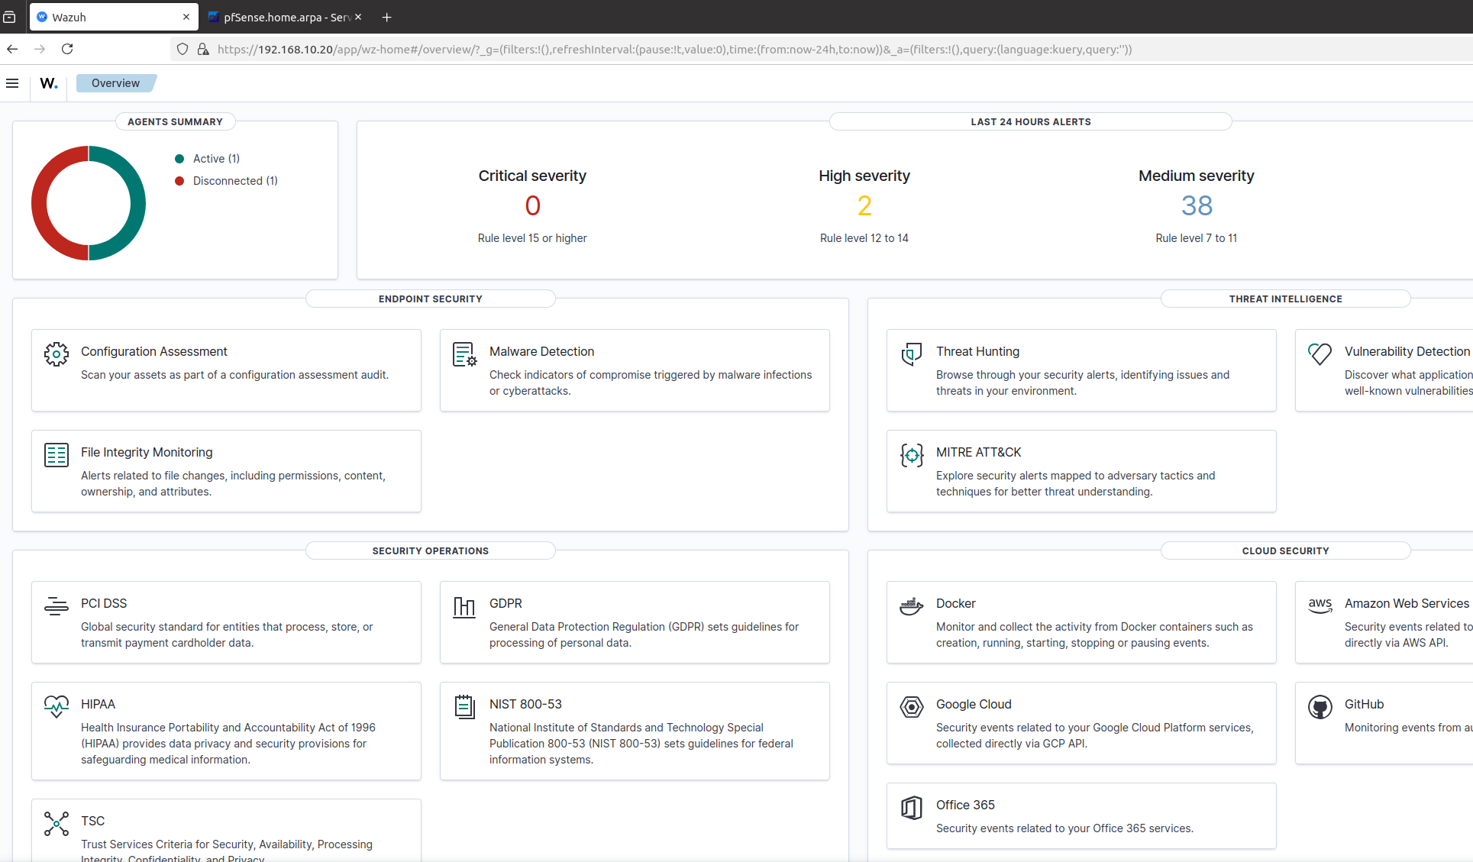
WAZUH Web Dashboard

Slide 13
Vulnerable System
IIS Webserver
Simulated attacker used for penetration testing
Logs captured by Wazuh agent
Used to evaluate system detection capabilities

Slide 14
Email Notification to Admin
Postfix server configured with Wazuh
Alerts sent based on severity thresholds (level 7 to ..)
Helps in immediate response and awareness

Slide 15
Demonstration
Attack attempt from Kali to vulnerable system
Suricata flags malicious traffic
Wazuh generates alert with attacker IP

Slide 16
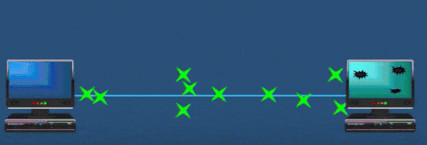
Attack Technique
sudo hping3 -S --flood -p 80 192.168.10.10
Part | Meaning
sudo | Runs the command with superuser privileges (required for raw packet crafting).
hping3 | A packet crafting tool for TCP/IP.
-S | Sends TCP packets with the SYN flag set.
--flood | Sends packets as fast as possible (used for flooding).
-p 80 | Targets port 80 (HTTP).
192.168.10.10 | Target IP address.
This command simulates a Denial of Service (DoS) attack

Slide 17
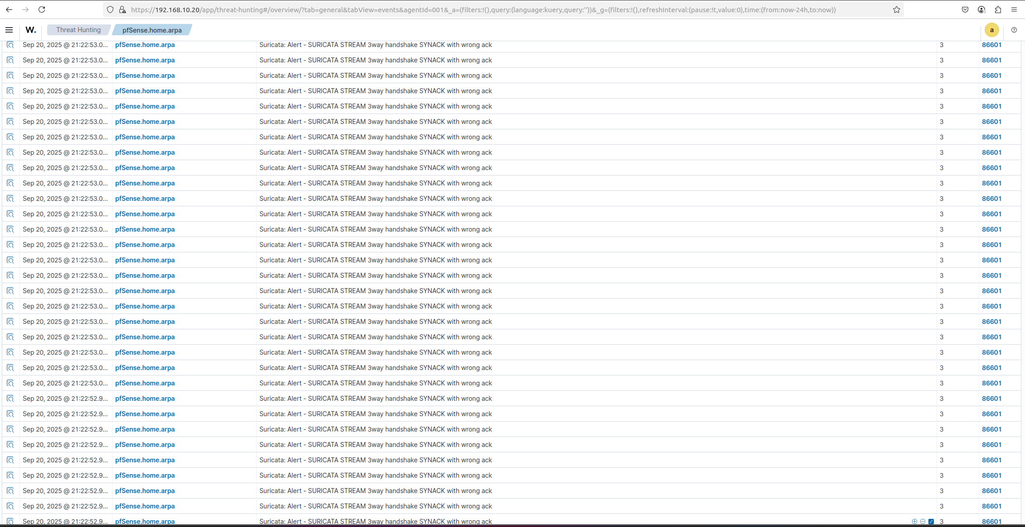
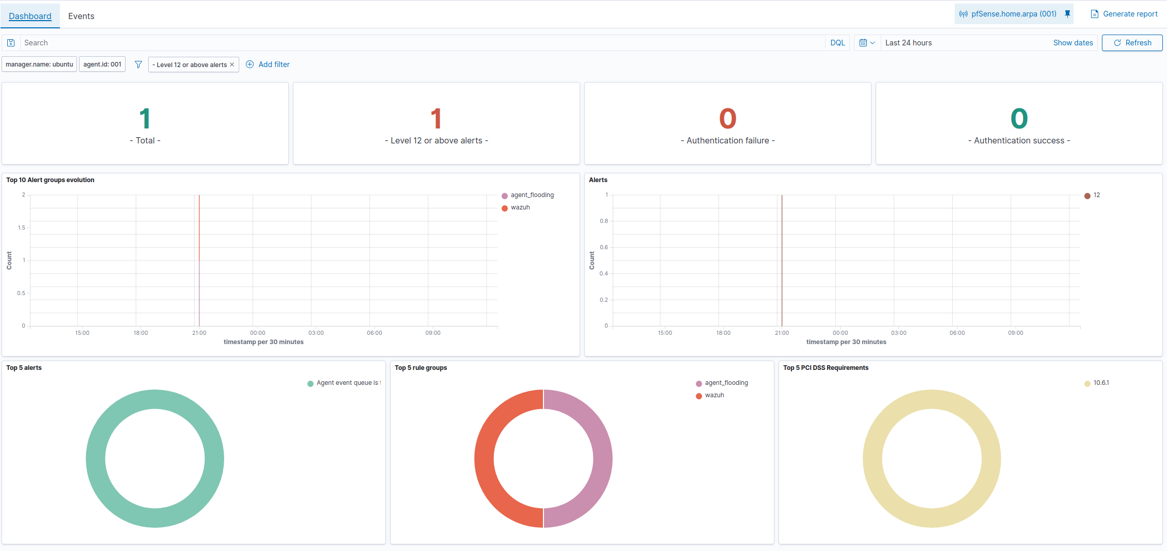

Slide 18
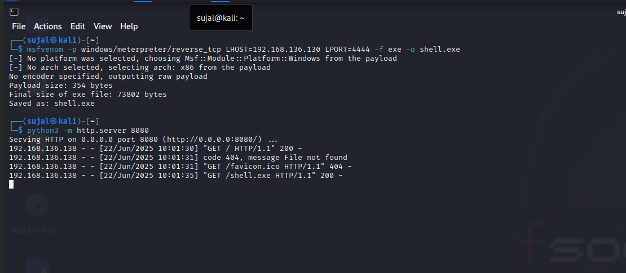
Metasploit

Slide 19
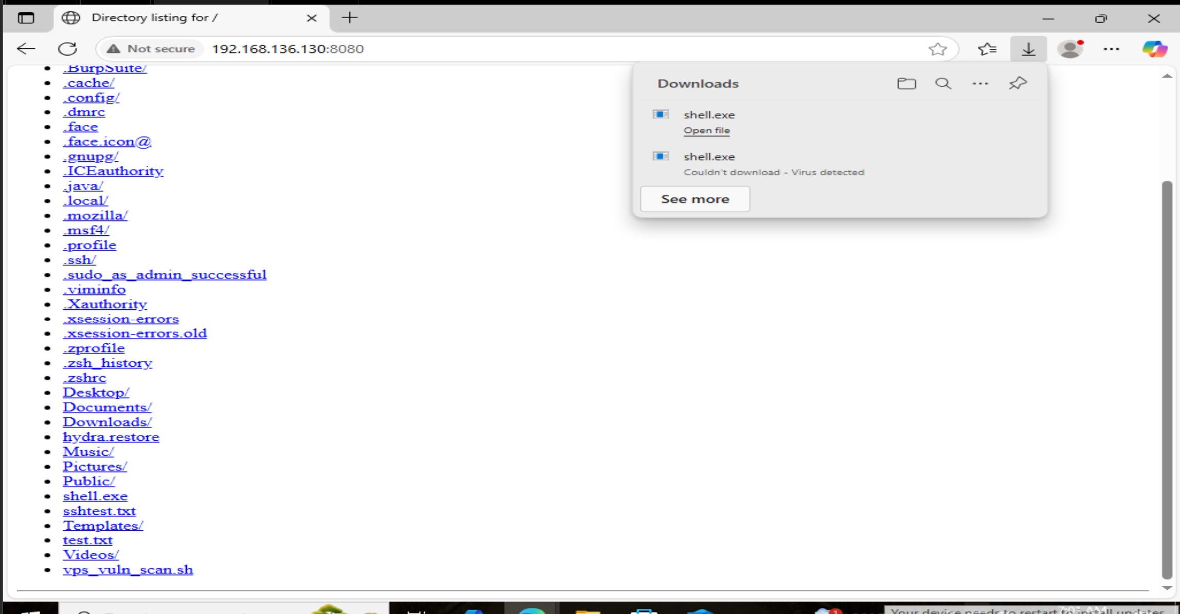

Slide 20
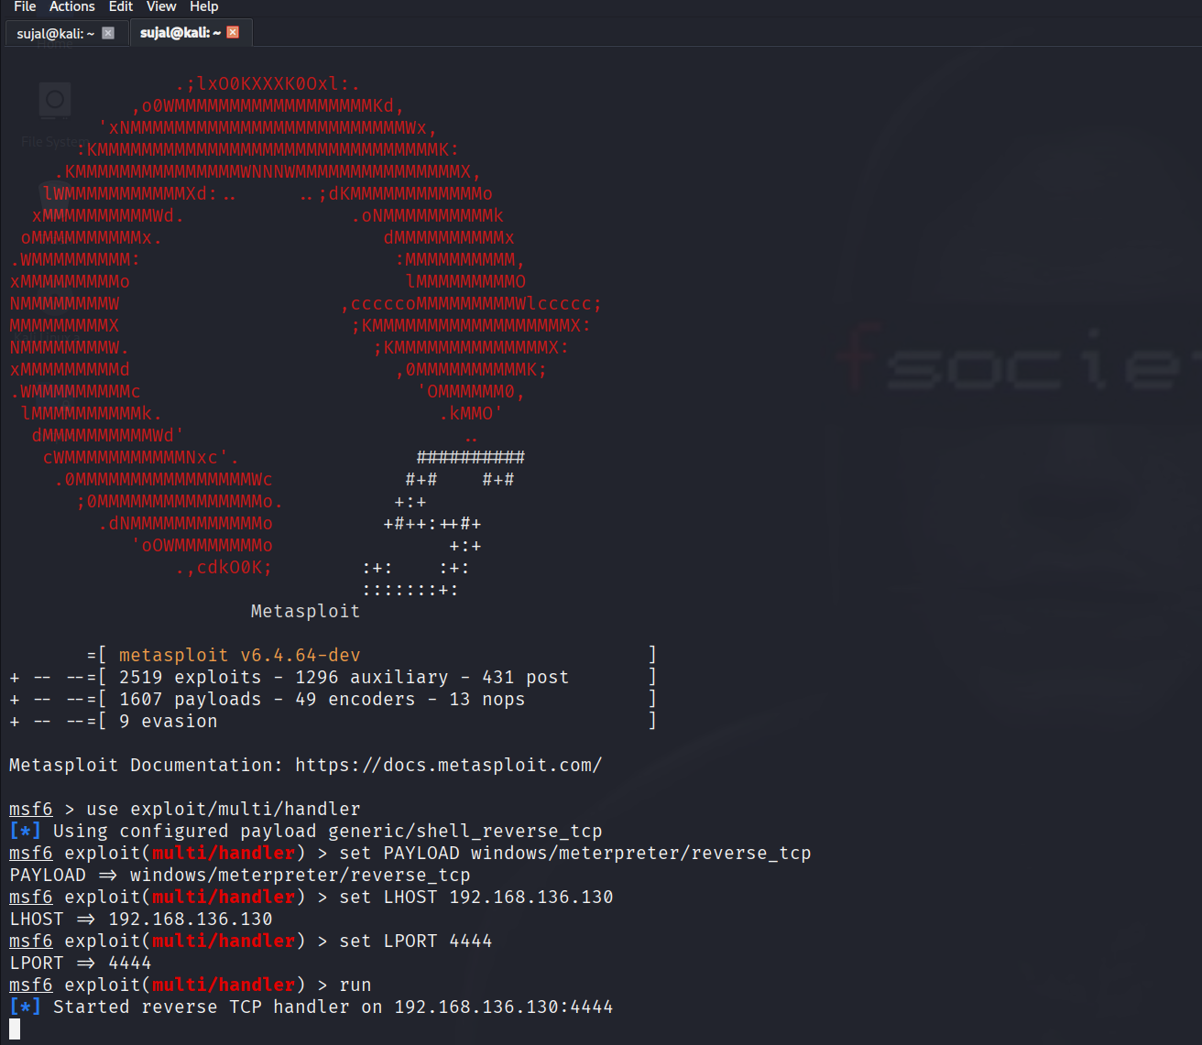
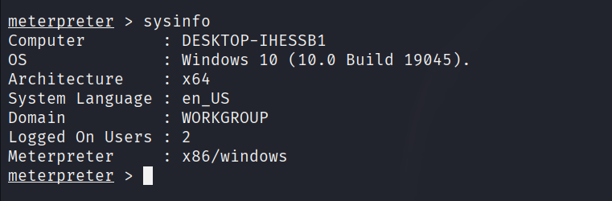
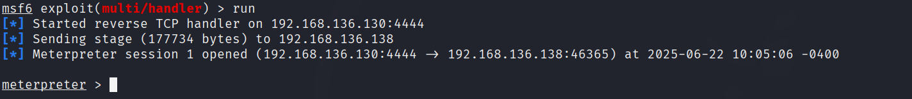
Listening on port 4444 (Attacker)
Victim System
Session started:

Slide 21
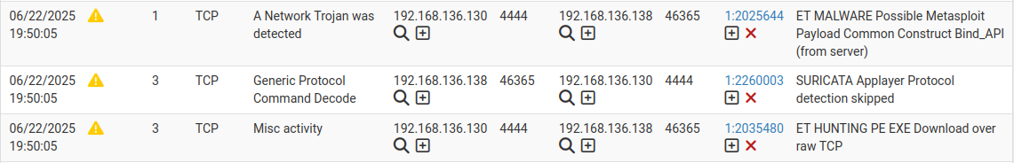
Alerts
In pfsense / suricata
In Wazuh Dashboard

Slide 22
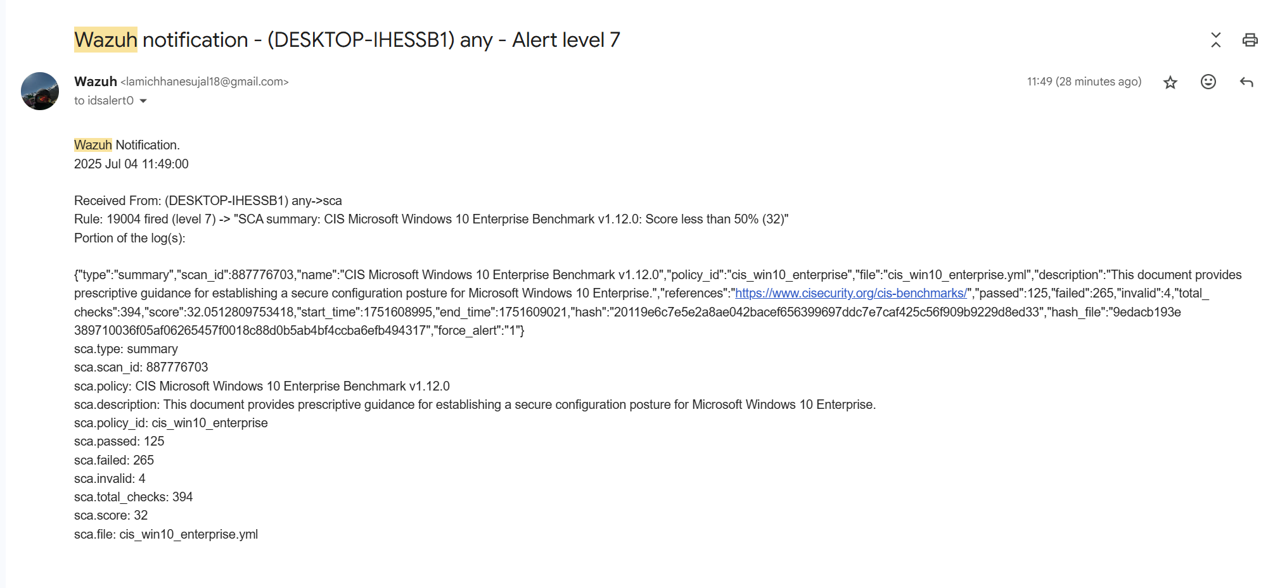
Email Notification sample

Slide 23
Budget Analysis
Item | Estimated Cost (USD)
Hardware (Servers/VM Hosts) | $1500
pfSense Hardware/VM Setup | $300
Suricata Setup | $0
Wazuh Server & Agents | $0
Networking Equipment | $600
Storage (Logs/Backups) | $400
Miscellaneous | $300
Total | $3100
US Dollar (USD) = 136.49 Nepalese Rupees (NPR)

Slide 24
Time Schedule
Date | Days | Tasks | Status
26 May – 1 June | 7 | Preliminary Research | Completed
2 June – 8 June | 7 | Infrastructure Preparation | Completed
9 June – 18 June | 10 | Tool Installation & Configuration | Completed
19 June – 27 June | 9 | System Integration | Completed
28 June – 5 July | 8 | Issue Resolution | Completed
6 July – 12 July | 7 | Testing & Verification | Completed
13 July – 19 July | 7 | Final Reporting & Documentation | Completed
20 July | 1 | Buffer & Submission | Completed

Slide 25
Conclusion
This project demonstrates that a robust, multi-layered cybersecurity monitoring system can be built using open-source tools like pfSense, Suricata, and Wazuh.
Through simulated attacks and real-time log analysis, this project successfully:
Detected and alerted on various threats (e.g., port scans, brute-force, exploit attempts)
Correlated host and network activity for deeper insight
Established a centralized, scalable, and affordable monitoring framework
This solution not only strengthens the security posture of small organizations and educational institutions but also serves as a practical platform for cybersecurity training and research.

Slide 26
Thank You

